Slide 1
A Novel CNN-LSTM Model for Classification of Horizontally Interchangeable Images
Li Xinwei, Luo Chengchang, Wei jingjue
Group 24, 2022.11.7
Notes:
Hello, professors. It’s my great honor to attend this interview.

Slide 2
Part 1. Introduction
Notes:
First, let me introduce myself briefly.

Slide 3
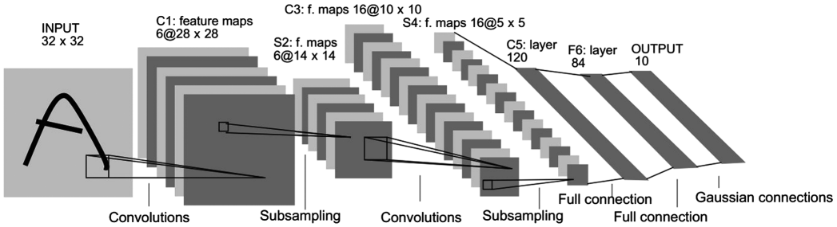
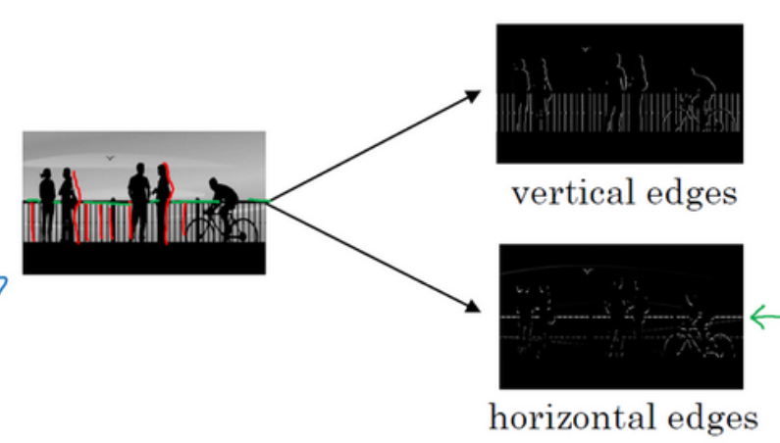
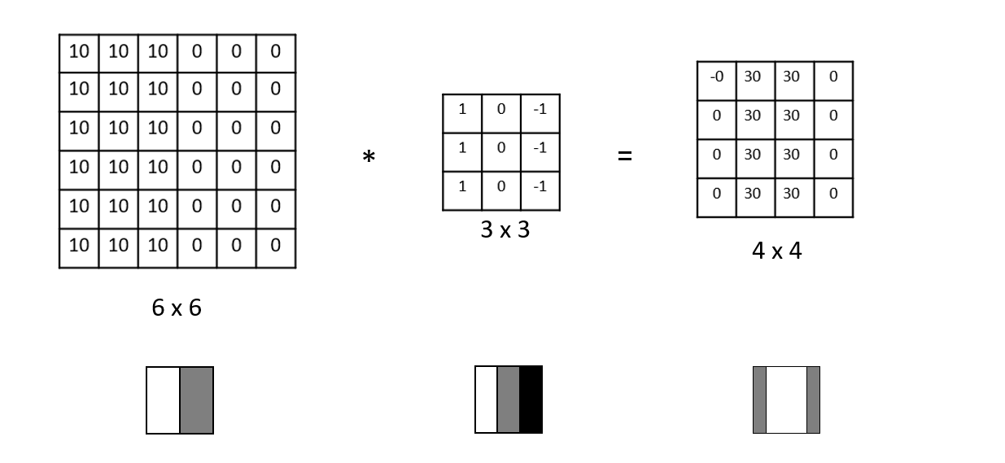
What is CNN-LSTM Model?
CNN (Convolutional Neural Network)
Capturing features of the image in each local blocks
Notes:
My name is Luo Chengchang. I graduated from Shanghai University in 2021 with a bachelor degree. During my undergraduate years, my major is Mathematics and Applied Mathematics, where I learned some basic math knowledge by taking courses such as Advanced Algebra and Mathematical Analysis, helping me to lay a good foundation for my future study. Besides, I also took some programming language courses such as C language, MATLAB, which are helpful for me to get started with other languages like R language I am using now.
Presently I’m majoring in statistics in National University of Singapore. During the past several semesters, I have taken courses such as Applied Regression Analysis and Statistical Analysis of Network, which are more applicable than my undergraduate courses since Advanced Algebra and Mathematical Analysis mainly focus on theories of math. For most courses I am taking now, we use R language to do some data analysis. That’s all about my person information.

Slide 4
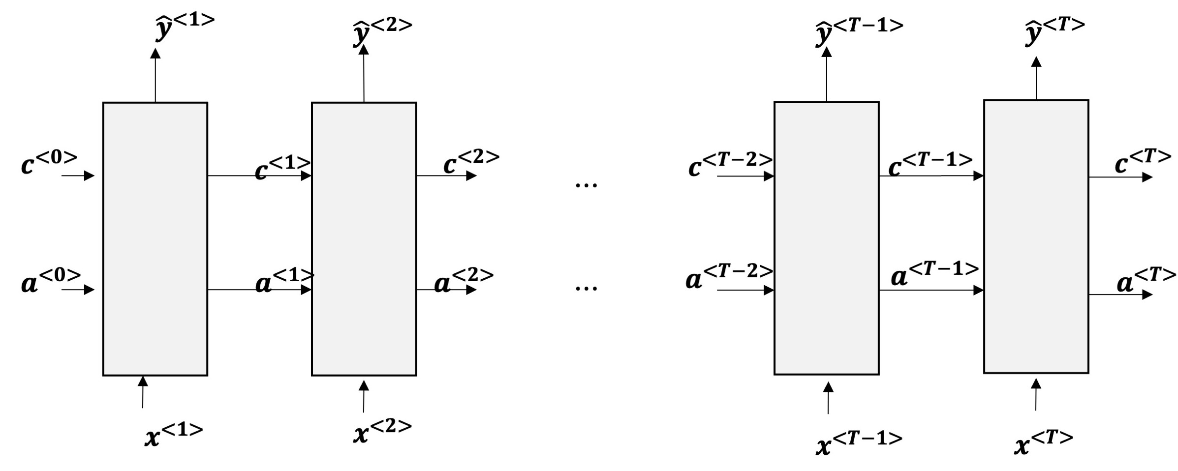
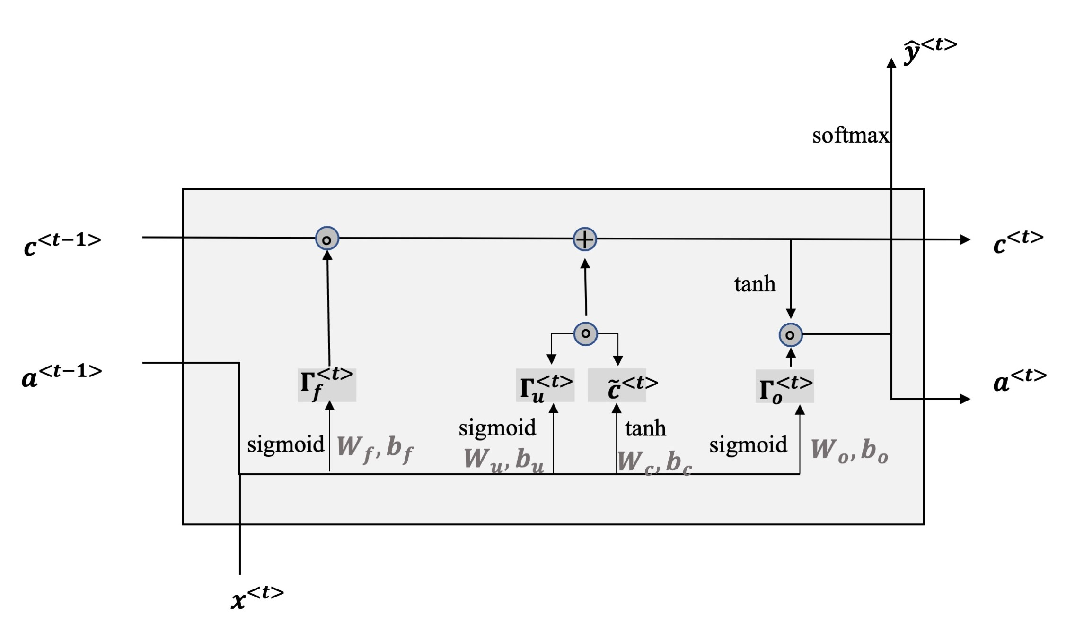
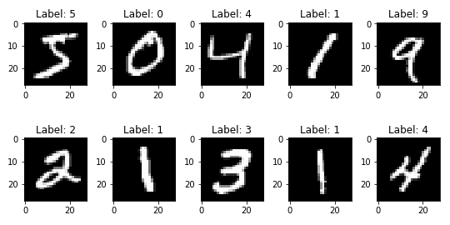
What is CNN-LSTM Model?
LSTM (Long-Short Term Memory)
LSTM in Image Classification
Each image are compromised by pixels with color;
Treat each image as a sequential of pixels , from left to right ,from top to bottom, whose value is RGB or grey value.
Considering the covariate among different locations in the image:
Less probability
higher probability
Notes:
My name is Luo Chengchang. I graduated from Shanghai University in 2021 with a bachelor degree. During my undergraduate years, my major is Mathematics and Applied Mathematics, where I learned some basic math knowledge by taking courses such as Advanced Algebra and Mathematical Analysis, helping me to lay a good foundation for my future study. Besides, I also took some programming language courses such as C language, MATLAB, which are helpful for me to get started with other languages like R language I am using now.
Presently I’m majoring in statistics in National University of Singapore. During the past several semesters, I have taken courses such as Applied Regression Analysis and Statistical Analysis of Network, which are more applicable than my undergraduate courses since Advanced Algebra and Mathematical Analysis mainly focus on theories of math. For most courses I am taking now, we use R language to do some data analysis. That’s all about my person information.

Slide 5
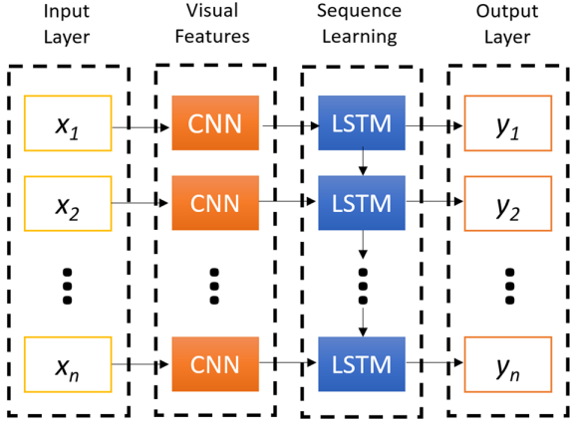
What is CNN-LSTM Model?
Three types of “CNN+LSTM” concept model:
CNN+LSTM structure
CNN
input
output
Parallel structure
LSTM
input
CNN
LSTM
output
CNN+LSTM structure
input
LSTM
CNN
output
LSTM+CNN structure
Notes:
My name is Luo Chengchang. I graduated from Shanghai University in 2021 with a bachelor degree. During my undergraduate years, my major is Mathematics and Applied Mathematics, where I learned some basic math knowledge by taking courses such as Advanced Algebra and Mathematical Analysis, helping me to lay a good foundation for my future study. Besides, I also took some programming language courses such as C language, MATLAB, which are helpful for me to get started with other languages like R language I am using now.
Presently I’m majoring in statistics in National University of Singapore. During the past several semesters, I have taken courses such as Applied Regression Analysis and Statistical Analysis of Network, which are more applicable than my undergraduate courses since Advanced Algebra and Mathematical Analysis mainly focus on theories of math. For most courses I am taking now, we use R language to do some data analysis. That’s all about my person information.

Slide 6
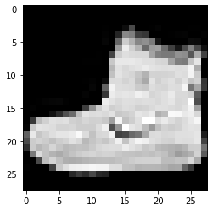
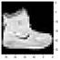

What is horizontally interchangeable Images?
Horizontally non-interchangeable images:
Horizontal flip of image probably changes the original label of image. E.g. handwriting numbers.
Horizontally Interchangeable images:
E.g. Fashionmnist dataset
Horizontal flip of images increases unnecessary noise for the image classification. E.g. detecting tumor from X-ray of brain/body.
Notes:
My name is Luo Chengchang. I graduated from Shanghai University in 2021 with a bachelor degree. During my undergraduate years, my major is Mathematics and Applied Mathematics, where I learned some basic math knowledge by taking courses such as Advanced Algebra and Mathematical Analysis, helping me to lay a good foundation for my future study. Besides, I also took some programming language courses such as C language, MATLAB, which are helpful for me to get started with other languages like R language I am using now.
Presently I’m majoring in statistics in National University of Singapore. During the past several semesters, I have taken courses such as Applied Regression Analysis and Statistical Analysis of Network, which are more applicable than my undergraduate courses since Advanced Algebra and Mathematical Analysis mainly focus on theories of math. For most courses I am taking now, we use R language to do some data analysis. That’s all about my person information.

Slide 7
Why we chose this topic & what we want to do
Current research gap
Objectives
The performance of CNN+LSTM structure horizontally interchangeable image is rarely discussed.
No specific development of CNN+LSTM structure for horizontally interchangeable image is made.
O1: Verify the effectiveness of CNN+LSTM structure compared with pure CNN for horizontally interchangeable image classification.
O2: Develop a novel CNN+LTSM structure for horizontally interchangeable image classification so that its performance can be better than that of general model.
Notes:
My name is Luo Chengchang. I graduated from Shanghai University in 2021 with a bachelor degree. During my undergraduate years, my major is Mathematics and Applied Mathematics, where I learned some basic math knowledge by taking courses such as Advanced Algebra and Mathematical Analysis, helping me to lay a good foundation for my future study. Besides, I also took some programming language courses such as C language, MATLAB, which are helpful for me to get started with other languages like R language I am using now.
Presently I’m majoring in statistics in National University of Singapore. During the past several semesters, I have taken courses such as Applied Regression Analysis and Statistical Analysis of Network, which are more applicable than my undergraduate courses since Advanced Algebra and Mathematical Analysis mainly focus on theories of math. For most courses I am taking now, we use R language to do some data analysis. That’s all about my person information.

Slide 8
Part 2. Dataset
Notes:
Then I would like to share my research experiences with you.

Slide 9
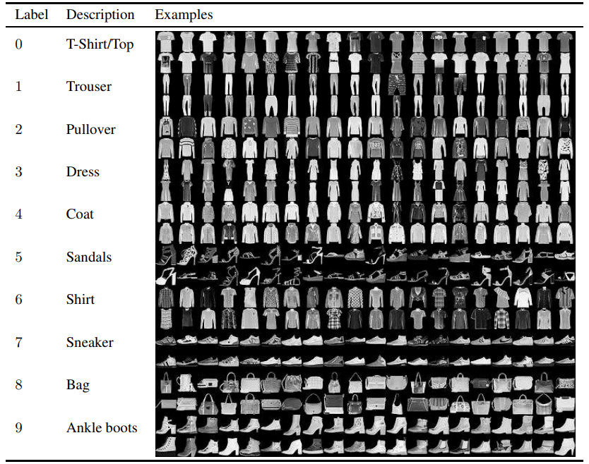
Fashion-MNIST
28x28 grayscale images of 70000 unique fashion products, based on the assortment on Zalando’s website.
Notes:
My name is Luo Chengchang. I graduated from Shanghai University in 2021 with a bachelor degree. During my undergraduate years, my major is Mathematics and Applied Mathematics, where I learned some basic math knowledge by taking courses such as Advanced Algebra and Mathematical Analysis, helping me to lay a good foundation for my future study. Besides, I also took some programming language courses such as C language, MATLAB, which are helpful for me to get started with other languages like R language I am using now.
Presently I’m majoring in statistics in National University of Singapore. During the past several semesters, I have taken courses such as Applied Regression Analysis and Statistical Analysis of Network, which are more applicable than my undergraduate courses since Advanced Algebra and Mathematical Analysis mainly focus on theories of math. For most courses I am taking now, we use R language to do some data analysis. That’s all about my person information.

Slide 10
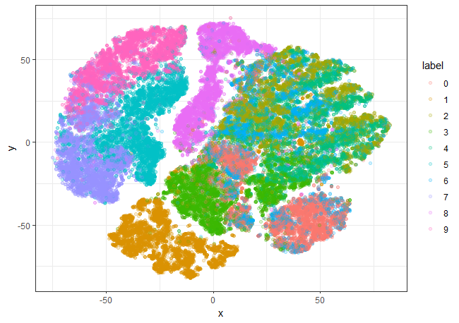
Why choose Fashion-MNIST?
Reasons for choosing Fashion-MNIST
1. Not too simple: many overlapping areas.
t-SNE Visualization on Raw Dataset
Notes:
My name is Luo Chengchang. I graduated from Shanghai University in 2021 with a bachelor degree. During my undergraduate years, my major is Mathematics and Applied Mathematics, where I learned some basic math knowledge by taking courses such as Advanced Algebra and Mathematical Analysis, helping me to lay a good foundation for my future study. Besides, I also took some programming language courses such as C language, MATLAB, which are helpful for me to get started with other languages like R language I am using now.
Presently I’m majoring in statistics in National University of Singapore. During the past several semesters, I have taken courses such as Applied Regression Analysis and Statistical Analysis of Network, which are more applicable than my undergraduate courses since Advanced Algebra and Mathematical Analysis mainly focus on theories of math. For most courses I am taking now, we use R language to do some data analysis. That’s all about my person information.

Slide 11
Why choose Fashion-MNIST?
2. Horizontally interchangeable images: Not be affected by horizontal flip
3. Balanced: 60000 examples in training set (each label with 6000 samples) and 10000
examples in test set (each label with 1000 samples)
4. Open source: easy to compare with other methods.
Notes:
My name is Luo Chengchang. I graduated from Shanghai University in 2021 with a bachelor degree. During my undergraduate years, my major is Mathematics and Applied Mathematics, where I learned some basic math knowledge by taking courses such as Advanced Algebra and Mathematical Analysis, helping me to lay a good foundation for my future study. Besides, I also took some programming language courses such as C language, MATLAB, which are helpful for me to get started with other languages like R language I am using now.
Presently I’m majoring in statistics in National University of Singapore. During the past several semesters, I have taken courses such as Applied Regression Analysis and Statistical Analysis of Network, which are more applicable than my undergraduate courses since Advanced Algebra and Mathematical Analysis mainly focus on theories of math. For most courses I am taking now, we use R language to do some data analysis. That’s all about my person information.

Slide 12
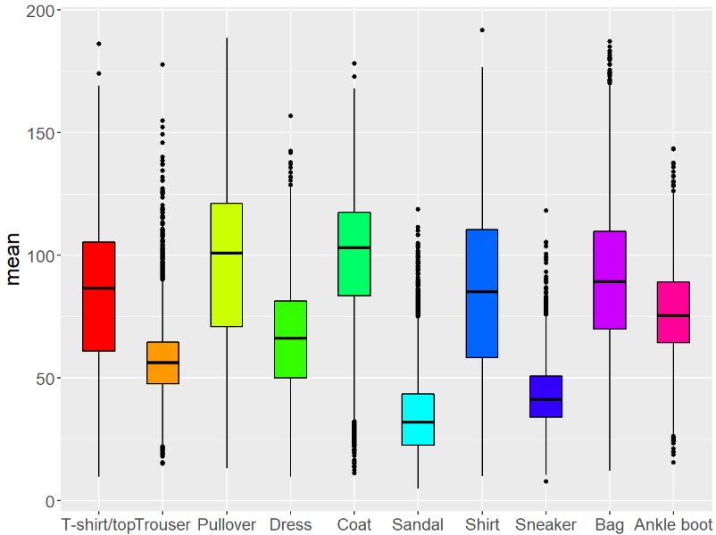
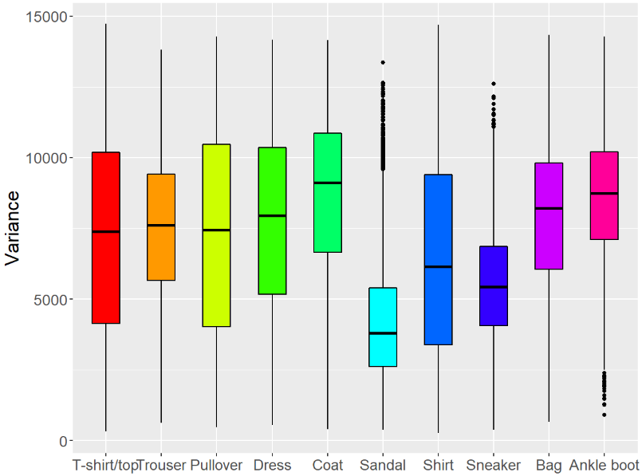
Explorative Research
Means of pixels
Variances of pixels
Notes:
My name is Luo Chengchang. I graduated from Shanghai University in 2021 with a bachelor degree. During my undergraduate years, my major is Mathematics and Applied Mathematics, where I learned some basic math knowledge by taking courses such as Advanced Algebra and Mathematical Analysis, helping me to lay a good foundation for my future study. Besides, I also took some programming language courses such as C language, MATLAB, which are helpful for me to get started with other languages like R language I am using now.
Presently I’m majoring in statistics in National University of Singapore. During the past several semesters, I have taken courses such as Applied Regression Analysis and Statistical Analysis of Network, which are more applicable than my undergraduate courses since Advanced Algebra and Mathematical Analysis mainly focus on theories of math. For most courses I am taking now, we use R language to do some data analysis. That’s all about my person information.

Slide 13
Part 3. Model & Evaluation
Notes:
And then I want to talk about my plan in UNNC.

Slide 14
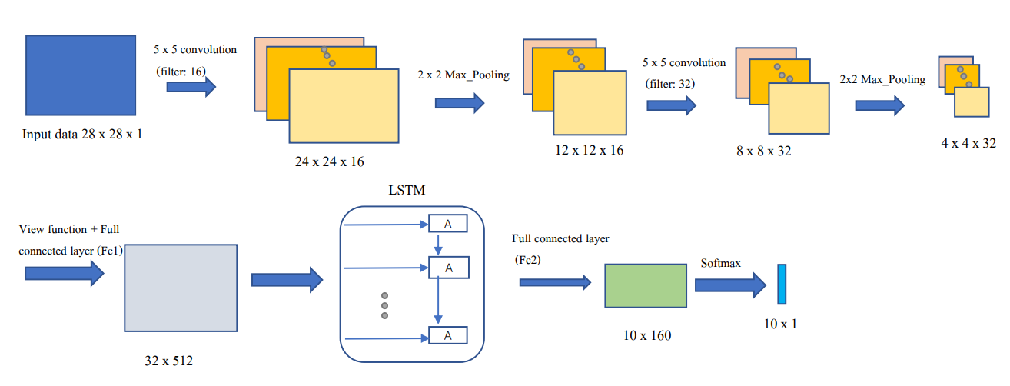
CNN-LSTM
Our CNN-LSTM model structure
Two CNN layers for feature extraction, one LSTM for sequence data prediction, and two fully-connected layers for classification.
Notes:
My name is Luo Chengchang. I graduated from Shanghai University in 2021 with a bachelor degree. During my undergraduate years, my major is Mathematics and Applied Mathematics, where I learned some basic math knowledge by taking courses such as Advanced Algebra and Mathematical Analysis, helping me to lay a good foundation for my future study. Besides, I also took some programming language courses such as C language, MATLAB, which are helpful for me to get started with other languages like R language I am using now.
Presently I’m majoring in statistics in National University of Singapore. During the past several semesters, I have taken courses such as Applied Regression Analysis and Statistical Analysis of Network, which are more applicable than my undergraduate courses since Advanced Algebra and Mathematical Analysis mainly focus on theories of math. For most courses I am taking now, we use R language to do some data analysis. That’s all about my person information.

Slide 15
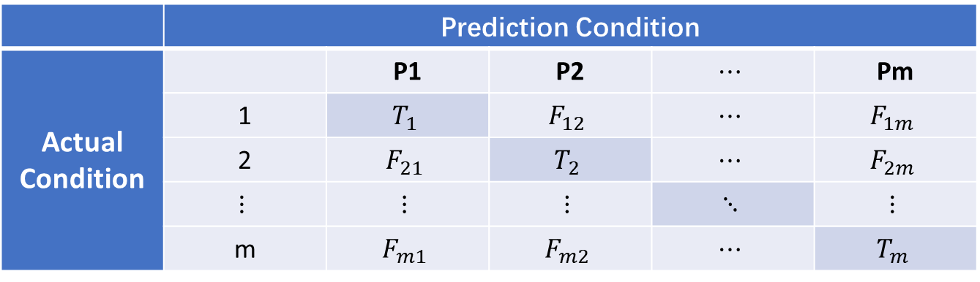
Evaluation Measures
Four metrics
Accuracy, F1 scores, AUC and t-SNE visualization.
1. 𝐹1 score takes the same value with total Accuracy in multi-class classification, where
we use confusion matrix of multi-class M in first two measures.
 | Prediction Condition
Actual Condition |  | P1 | P2 | $$⋯$$ | Pm
 | 1 | $$T_{1}$$ | $$F_{12}$$ | $$⋯$$ | $$F_{1m}$$
 | 2 | $$F_{21}$$ | $$T_{2}$$ | $$⋯$$ | $$F_{2m}$$
 | $$⋮$$ | $$⋮$$ | $$⋮$$ | $$⋱$$ | $$⋮$$
 | m | $$F_{m1}$$ | $$F_{m2}$$ | $$⋯$$ | $$T_{m}$$
Notes:
My name is Luo Chengchang. I graduated from Shanghai University in 2021 with a bachelor degree. During my undergraduate years, my major is Mathematics and Applied Mathematics, where I learned some basic math knowledge by taking courses such as Advanced Algebra and Mathematical Analysis, helping me to lay a good foundation for my future study. Besides, I also took some programming language courses such as C language, MATLAB, which are helpful for me to get started with other languages like R language I am using now.
Presently I’m majoring in statistics in National University of Singapore. During the past several semesters, I have taken courses such as Applied Regression Analysis and Statistical Analysis of Network, which are more applicable than my undergraduate courses since Advanced Algebra and Mathematical Analysis mainly focus on theories of math. For most courses I am taking now, we use R language to do some data analysis. That’s all about my person information.

Slide 16
Results
Four CNN-LSTM models
Two CNN models and two CNN-LSTM models.
Model1 | Structure | Model2 | Structure | Model3 | Structure | Model4 | Structure
Conv1 | (1, 16, 5) | Conv1 | (1, 8, 5) | Conv1 | (1, 8, 5) | Conv1 | (1, 16, 5)
Pool1 | (2,2) | Pool1 | (2,2) | Pool1 | (2,2) | Pool1 | (2,2)
Conv2 | (16, 32, 5) | Conv2 | (8, 32, 5) | Conv2 | (8, 32, 5) | Conv2 | (16, 32, 5)
Pool2 | (2,2) | Pool2 | (2,2) | Pool2 | (2,2) | Pool2 | (2,2)
Fc1 | (512,32) | Fc1 | (512,64) | Fc1 | (512,64) | Fc1 | (512,32)
LSTM | (32,160,1) | LSTM | (64,320,1) | X | X | X | X
Fc2 | (160,10) | Fc2 | (320,10) | Fc2 | (64,10) | Fc2 | (32,10)
Softmax | 10 | Softmax | 10 | Softmax | 10 | Softmax | 10
Accuracy | 89.76% | Accuracy | 90.38% | Accuracy | 86.55% | Accuracy | 86.28%
Notes:
My name is Luo Chengchang. I graduated from Shanghai University in 2021 with a bachelor degree. During my undergraduate years, my major is Mathematics and Applied Mathematics, where I learned some basic math knowledge by taking courses such as Advanced Algebra and Mathematical Analysis, helping me to lay a good foundation for my future study. Besides, I also took some programming language courses such as C language, MATLAB, which are helpful for me to get started with other languages like R language I am using now.
Presently I’m majoring in statistics in National University of Singapore. During the past several semesters, I have taken courses such as Applied Regression Analysis and Statistical Analysis of Network, which are more applicable than my undergraduate courses since Advanced Algebra and Mathematical Analysis mainly focus on theories of math. For most courses I am taking now, we use R language to do some data analysis. That’s all about my person information.

Slide 17
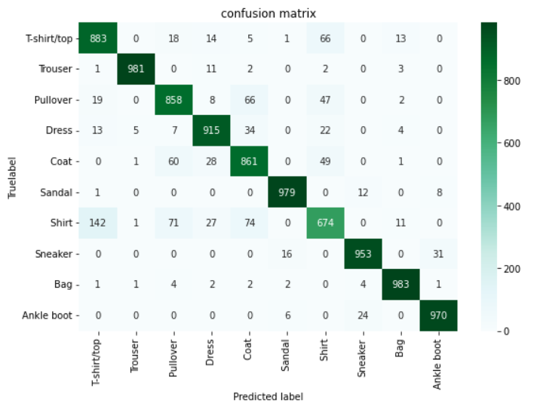
Results
Notes:
My name is Luo Chengchang. I graduated from Shanghai University in 2021 with a bachelor degree. During my undergraduate years, my major is Mathematics and Applied Mathematics, where I learned some basic math knowledge by taking courses such as Advanced Algebra and Mathematical Analysis, helping me to lay a good foundation for my future study. Besides, I also took some programming language courses such as C language, MATLAB, which are helpful for me to get started with other languages like R language I am using now.
Presently I’m majoring in statistics in National University of Singapore. During the past several semesters, I have taken courses such as Applied Regression Analysis and Statistical Analysis of Network, which are more applicable than my undergraduate courses since Advanced Algebra and Mathematical Analysis mainly focus on theories of math. For most courses I am taking now, we use R language to do some data analysis. That’s all about my person information.

Slide 18
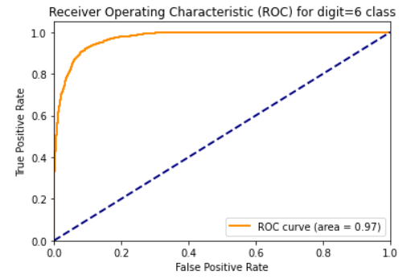
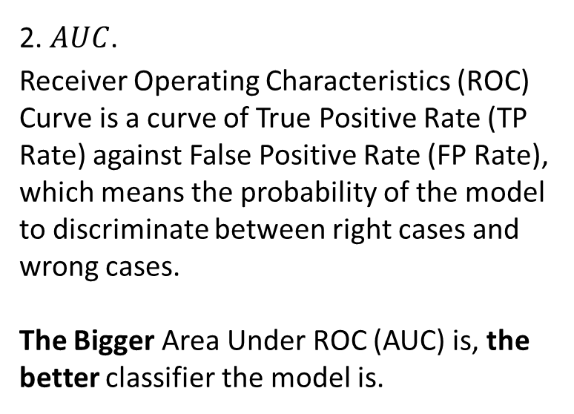
Results
2. $AUC$.
Receiver Operating Characteristics (ROC) Curve is a curve of True Positive Rate (TP Rate) against False Positive Rate (FP Rate), which means the probability of the model to discriminate between right cases and wrong cases.
The Bigger Area Under ROC (AUC) is, the better classifier the model is.
Notes:
My name is Luo Chengchang. I graduated from Shanghai University in 2021 with a bachelor degree. During my undergraduate years, my major is Mathematics and Applied Mathematics, where I learned some basic math knowledge by taking courses such as Advanced Algebra and Mathematical Analysis, helping me to lay a good foundation for my future study. Besides, I also took some programming language courses such as C language, MATLAB, which are helpful for me to get started with other languages like R language I am using now.
Presently I’m majoring in statistics in National University of Singapore. During the past several semesters, I have taken courses such as Applied Regression Analysis and Statistical Analysis of Network, which are more applicable than my undergraduate courses since Advanced Algebra and Mathematical Analysis mainly focus on theories of math. For most courses I am taking now, we use R language to do some data analysis. That’s all about my person information.

Slide 19
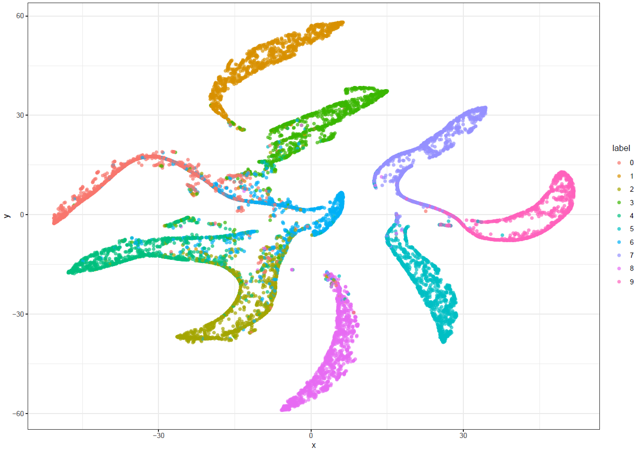
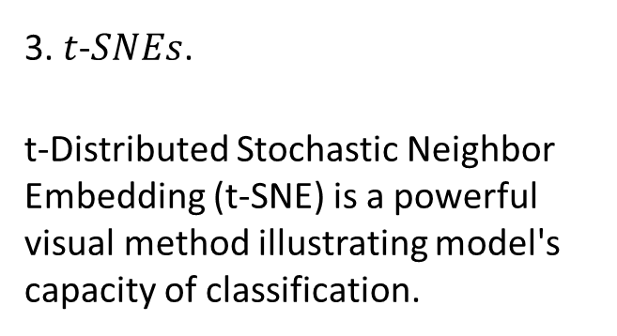
Results
3. $t$-$SNEs$.
t-Distributed Stochastic Neighbor Embedding (t-SNE) is a powerful visual method illustrating model's capacity of classification.
CNN+LSTM
accuracy: 90.38%
Notes:
My name is Luo Chengchang. I graduated from Shanghai University in 2021 with a bachelor degree. During my undergraduate years, my major is Mathematics and Applied Mathematics, where I learned some basic math knowledge by taking courses such as Advanced Algebra and Mathematical Analysis, helping me to lay a good foundation for my future study. Besides, I also took some programming language courses such as C language, MATLAB, which are helpful for me to get started with other languages like R language I am using now.
Presently I’m majoring in statistics in National University of Singapore. During the past several semesters, I have taken courses such as Applied Regression Analysis and Statistical Analysis of Network, which are more applicable than my undergraduate courses since Advanced Algebra and Mathematical Analysis mainly focus on theories of math. For most courses I am taking now, we use R language to do some data analysis. That’s all about my person information.

Slide 20
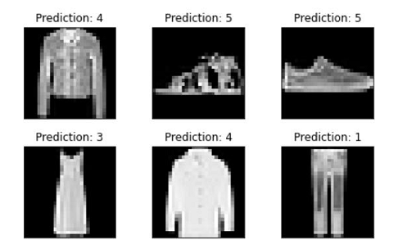
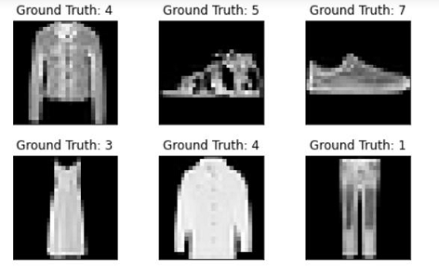
Results
Examples from CNN-LSTM model
Prediction
True label
Notes:
My name is Luo Chengchang. I graduated from Shanghai University in 2021 with a bachelor degree. During my undergraduate years, my major is Mathematics and Applied Mathematics, where I learned some basic math knowledge by taking courses such as Advanced Algebra and Mathematical Analysis, helping me to lay a good foundation for my future study. Besides, I also took some programming language courses such as C language, MATLAB, which are helpful for me to get started with other languages like R language I am using now.
Presently I’m majoring in statistics in National University of Singapore. During the past several semesters, I have taken courses such as Applied Regression Analysis and Statistical Analysis of Network, which are more applicable than my undergraduate courses since Advanced Algebra and Mathematical Analysis mainly focus on theories of math. For most courses I am taking now, we use R language to do some data analysis. That’s all about my person information.

Slide 21
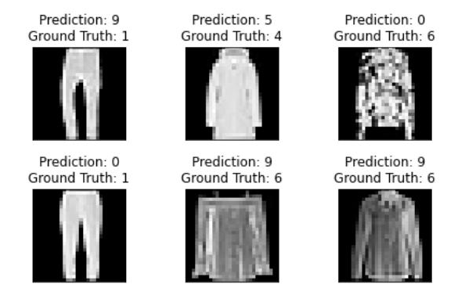
Results
Mis-labeled output from CNN-LSTM model
Notes:
My name is Luo Chengchang. I graduated from Shanghai University in 2021 with a bachelor degree. During my undergraduate years, my major is Mathematics and Applied Mathematics, where I learned some basic math knowledge by taking courses such as Advanced Algebra and Mathematical Analysis, helping me to lay a good foundation for my future study. Besides, I also took some programming language courses such as C language, MATLAB, which are helpful for me to get started with other languages like R language I am using now.
Presently I’m majoring in statistics in National University of Singapore. During the past several semesters, I have taken courses such as Applied Regression Analysis and Statistical Analysis of Network, which are more applicable than my undergraduate courses since Advanced Algebra and Mathematical Analysis mainly focus on theories of math. For most courses I am taking now, we use R language to do some data analysis. That’s all about my person information.

Slide 22
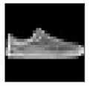
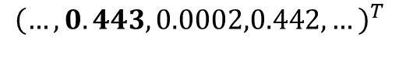
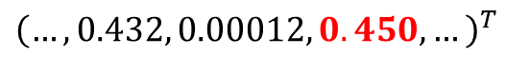
Random Flip & Aggregated Output
Random flip:
For each mini-batch in each epoch,
Set each image with 50% chance to horizontally flipped before going into the training procedure.
Goal: Potentially augment training data size twice----Data enhancement.
Aggregated Output:
When predicting the test image label, instead of using the label with highest value of CNN+LSTM output, using the label with global highest value combining output of both original image and its horizontally flipped image.
Original output
5
CNN+LSTM
Probs of each label is true
$${\left(…,0.443,0.0002,0.442,…\right)}^{T}$$
Original
Label 5
Label 7
7
CNN+LSTM
Probs of each label is true
Aggregated output
$${\left(…,0.432, 0.00012, 0.450,…\right)}^{T}$$
Horizontally flipped
7
Horizontally flipped output
Notes:
My name is Luo Chengchang. I graduated from Shanghai University in 2021 with a bachelor degree. During my undergraduate years, my major is Mathematics and Applied Mathematics, where I learned some basic math knowledge by taking courses such as Advanced Algebra and Mathematical Analysis, helping me to lay a good foundation for my future study. Besides, I also took some programming language courses such as C language, MATLAB, which are helpful for me to get started with other languages like R language I am using now.
Presently I’m majoring in statistics in National University of Singapore. During the past several semesters, I have taken courses such as Applied Regression Analysis and Statistical Analysis of Network, which are more applicable than my undergraduate courses since Advanced Algebra and Mathematical Analysis mainly focus on theories of math. For most courses I am taking now, we use R language to do some data analysis. That’s all about my person information.

Slide 23
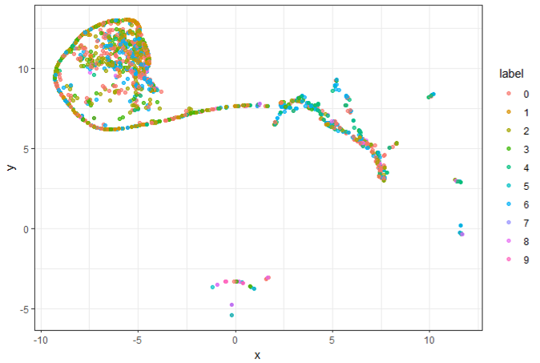
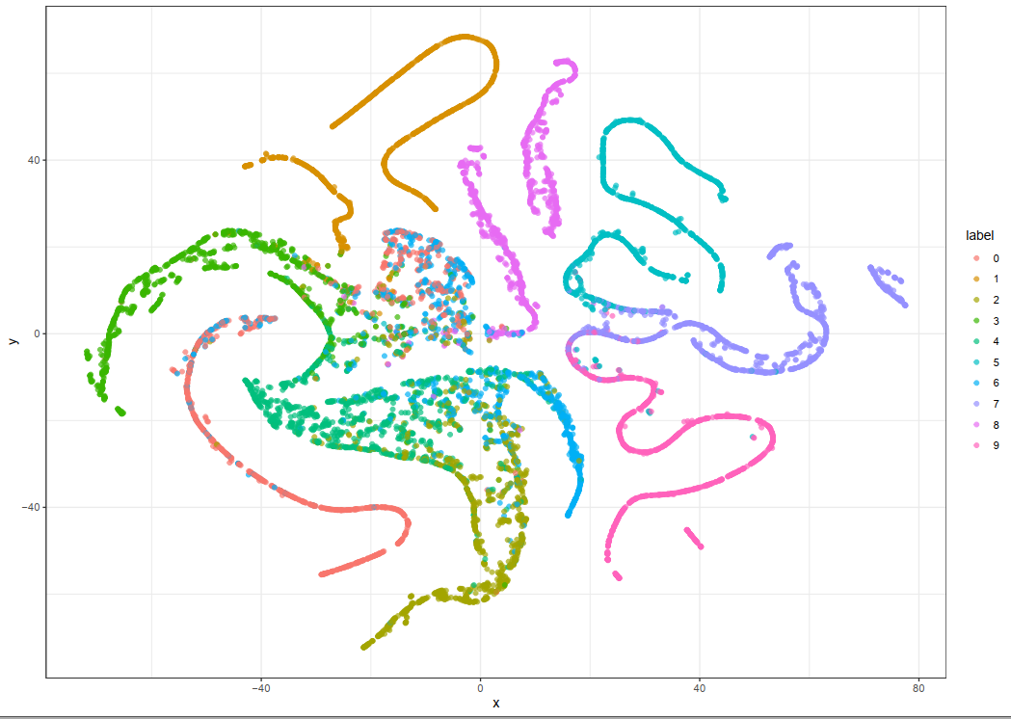
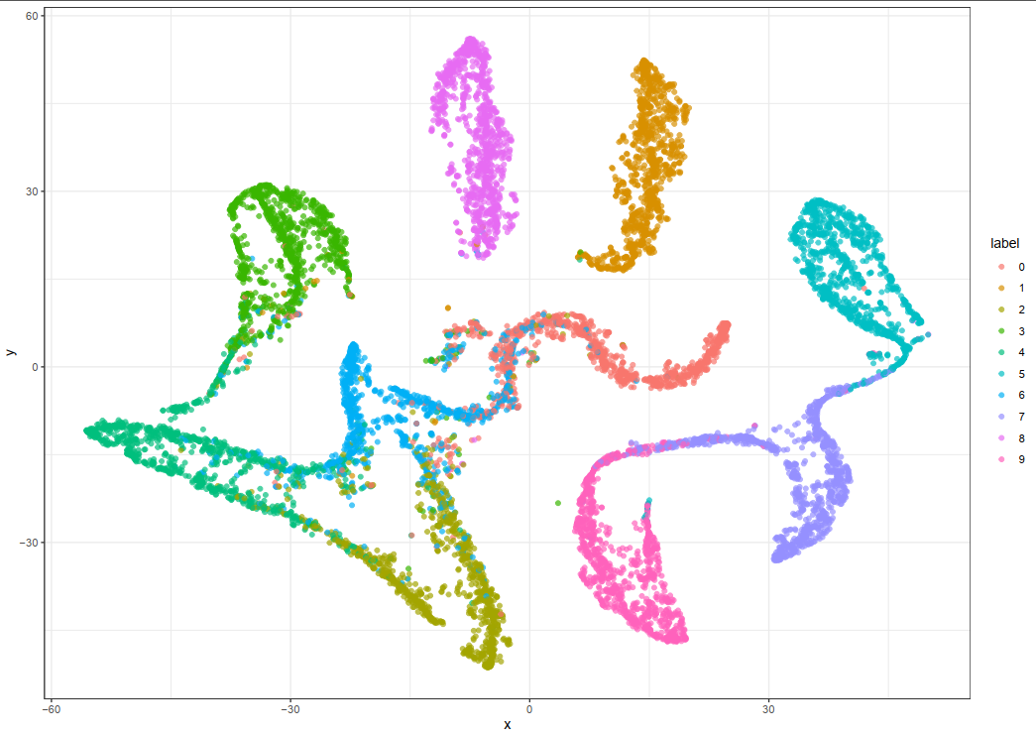
Results
Four t-SNE visualization figures
Original test data
The best performance of CNN+LSTM on Fashion-MNIST data set is 91.36% by Ji, Y. (2022, June).
CNN+LSTM
accuracy: 90.5%
CNN
accuracy: 86.55%
CNN+LSTM with random horizontally flip and aggregated output.
accuracy: 91.43%
Notes:
My name is Luo Chengchang. I graduated from Shanghai University in 2021 with a bachelor degree. During my undergraduate years, my major is Mathematics and Applied Mathematics, where I learned some basic math knowledge by taking courses such as Advanced Algebra and Mathematical Analysis, helping me to lay a good foundation for my future study. Besides, I also took some programming language courses such as C language, MATLAB, which are helpful for me to get started with other languages like R language I am using now.
Presently I’m majoring in statistics in National University of Singapore. During the past several semesters, I have taken courses such as Applied Regression Analysis and Statistical Analysis of Network, which are more applicable than my undergraduate courses since Advanced Algebra and Mathematical Analysis mainly focus on theories of math. For most courses I am taking now, we use R language to do some data analysis. That’s all about my person information.

Slide 24
Part 4. Summary
Notes:
And then I want to talk about my plan in UNNC.

Slide 25
Contributions
Novel Guide for classification Interchangeable Images applying CNN-LSTM model
Combining horizontally randomly flip while training and aggregated output while outputting, We successfully improve the accuracy of classification without adding more computational time.
Better Visualization of Results
Introducing t-SNE plots with PCA Initialization to show the visual results without loss of the rigorousness.
Best Performance
Among all CNN-LSTM models on Fashion-MNIST dataset, our model obtains the best results, whose accuracy is 91.43%.
The former best performance of CNN+LSTM on Fashionmnist data set is 91.36% by Ji, Y. (2022, June).
Notes:
My name is Luo Chengchang. I graduated from Shanghai University in 2021 with a bachelor degree. During my undergraduate years, my major is Mathematics and Applied Mathematics, where I learned some basic math knowledge by taking courses such as Advanced Algebra and Mathematical Analysis, helping me to lay a good foundation for my future study. Besides, I also took some programming language courses such as C language, MATLAB, which are helpful for me to get started with other languages like R language I am using now.
Presently I’m majoring in statistics in National University of Singapore. During the past several semesters, I have taken courses such as Applied Regression Analysis and Statistical Analysis of Network, which are more applicable than my undergraduate courses since Advanced Algebra and Mathematical Analysis mainly focus on theories of math. For most courses I am taking now, we use R language to do some data analysis. That’s all about my person information.

Slide 26
Q & A
Notes:
My name is Luo Chengchang. I graduated from Shanghai University in 2021 with a bachelor degree. During my undergraduate years, my major is Mathematics and Applied Mathematics, where I learned some basic math knowledge by taking courses such as Advanced Algebra and Mathematical Analysis, helping me to lay a good foundation for my future study. Besides, I also took some programming language courses such as C language, MATLAB, which are helpful for me to get started with other languages like R language I am using now.
Presently I’m majoring in statistics in National University of Singapore. During the past several semesters, I have taken courses such as Applied Regression Analysis and Statistical Analysis of Network, which are more applicable than my undergraduate courses since Advanced Algebra and Mathematical Analysis mainly focus on theories of math. For most courses I am taking now, we use R language to do some data analysis. That’s all about my person information.

Slide 27
Thanks
Notes:
That’s all about my presentation. Thanks for your listening.

